Slide 1
JASM graphs

Slide 2
Wetland area
CO₂
CH₄
Gas exchange
CO₂
CH₄
CO₂-enriched groundwater
CO₂
Gas exchange
CH₄
CO₂
CH₄
CO₂-enriched groundwater

Slide 3
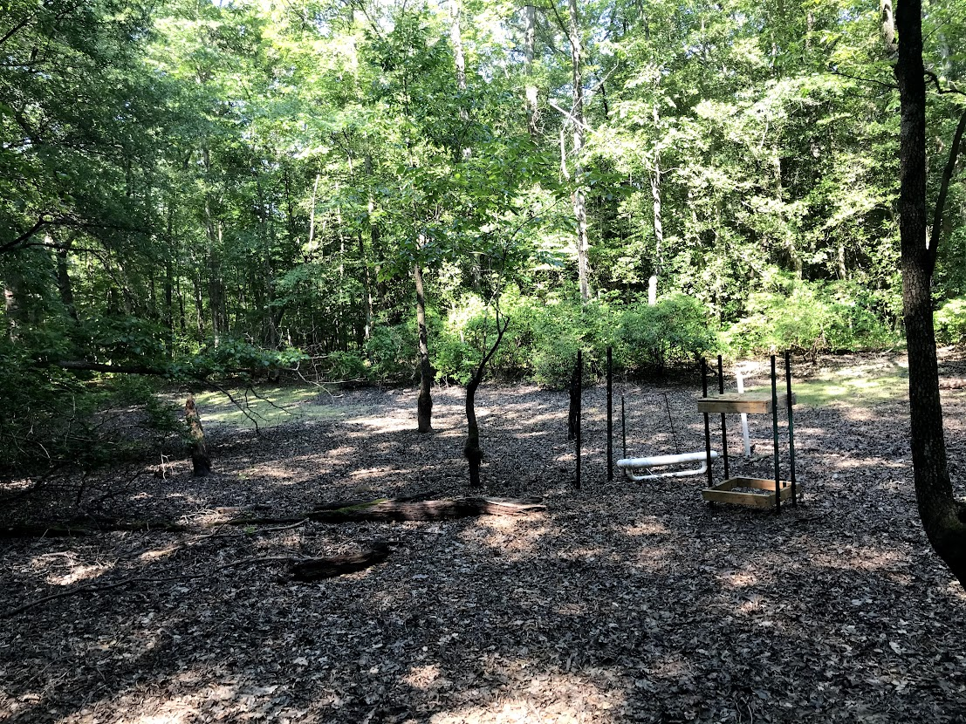
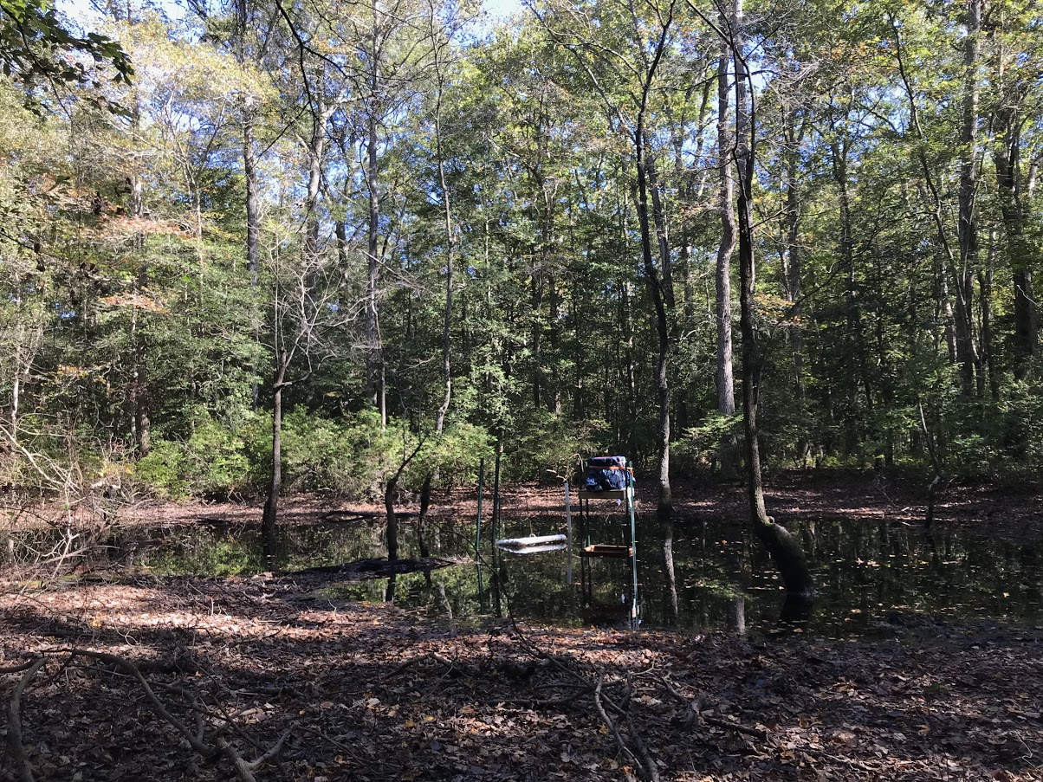

Slide 4
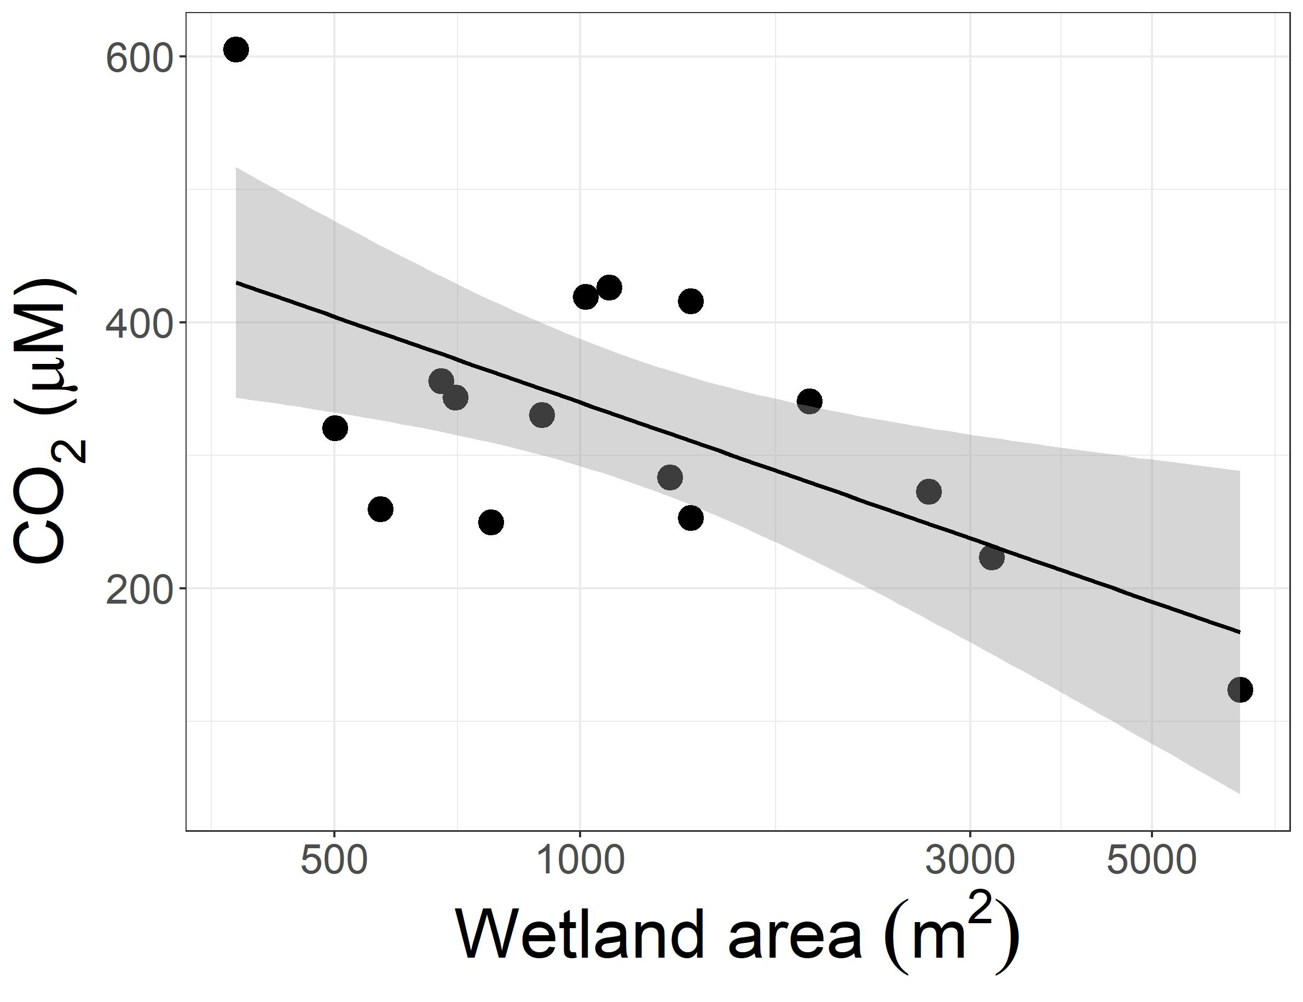
p-value = 0.01015
R² =
Multiple R-squared: 0.3864
Adjusted R-squared: 0.3426
p-value = 0.01015
R² = 0.3426

Slide 5
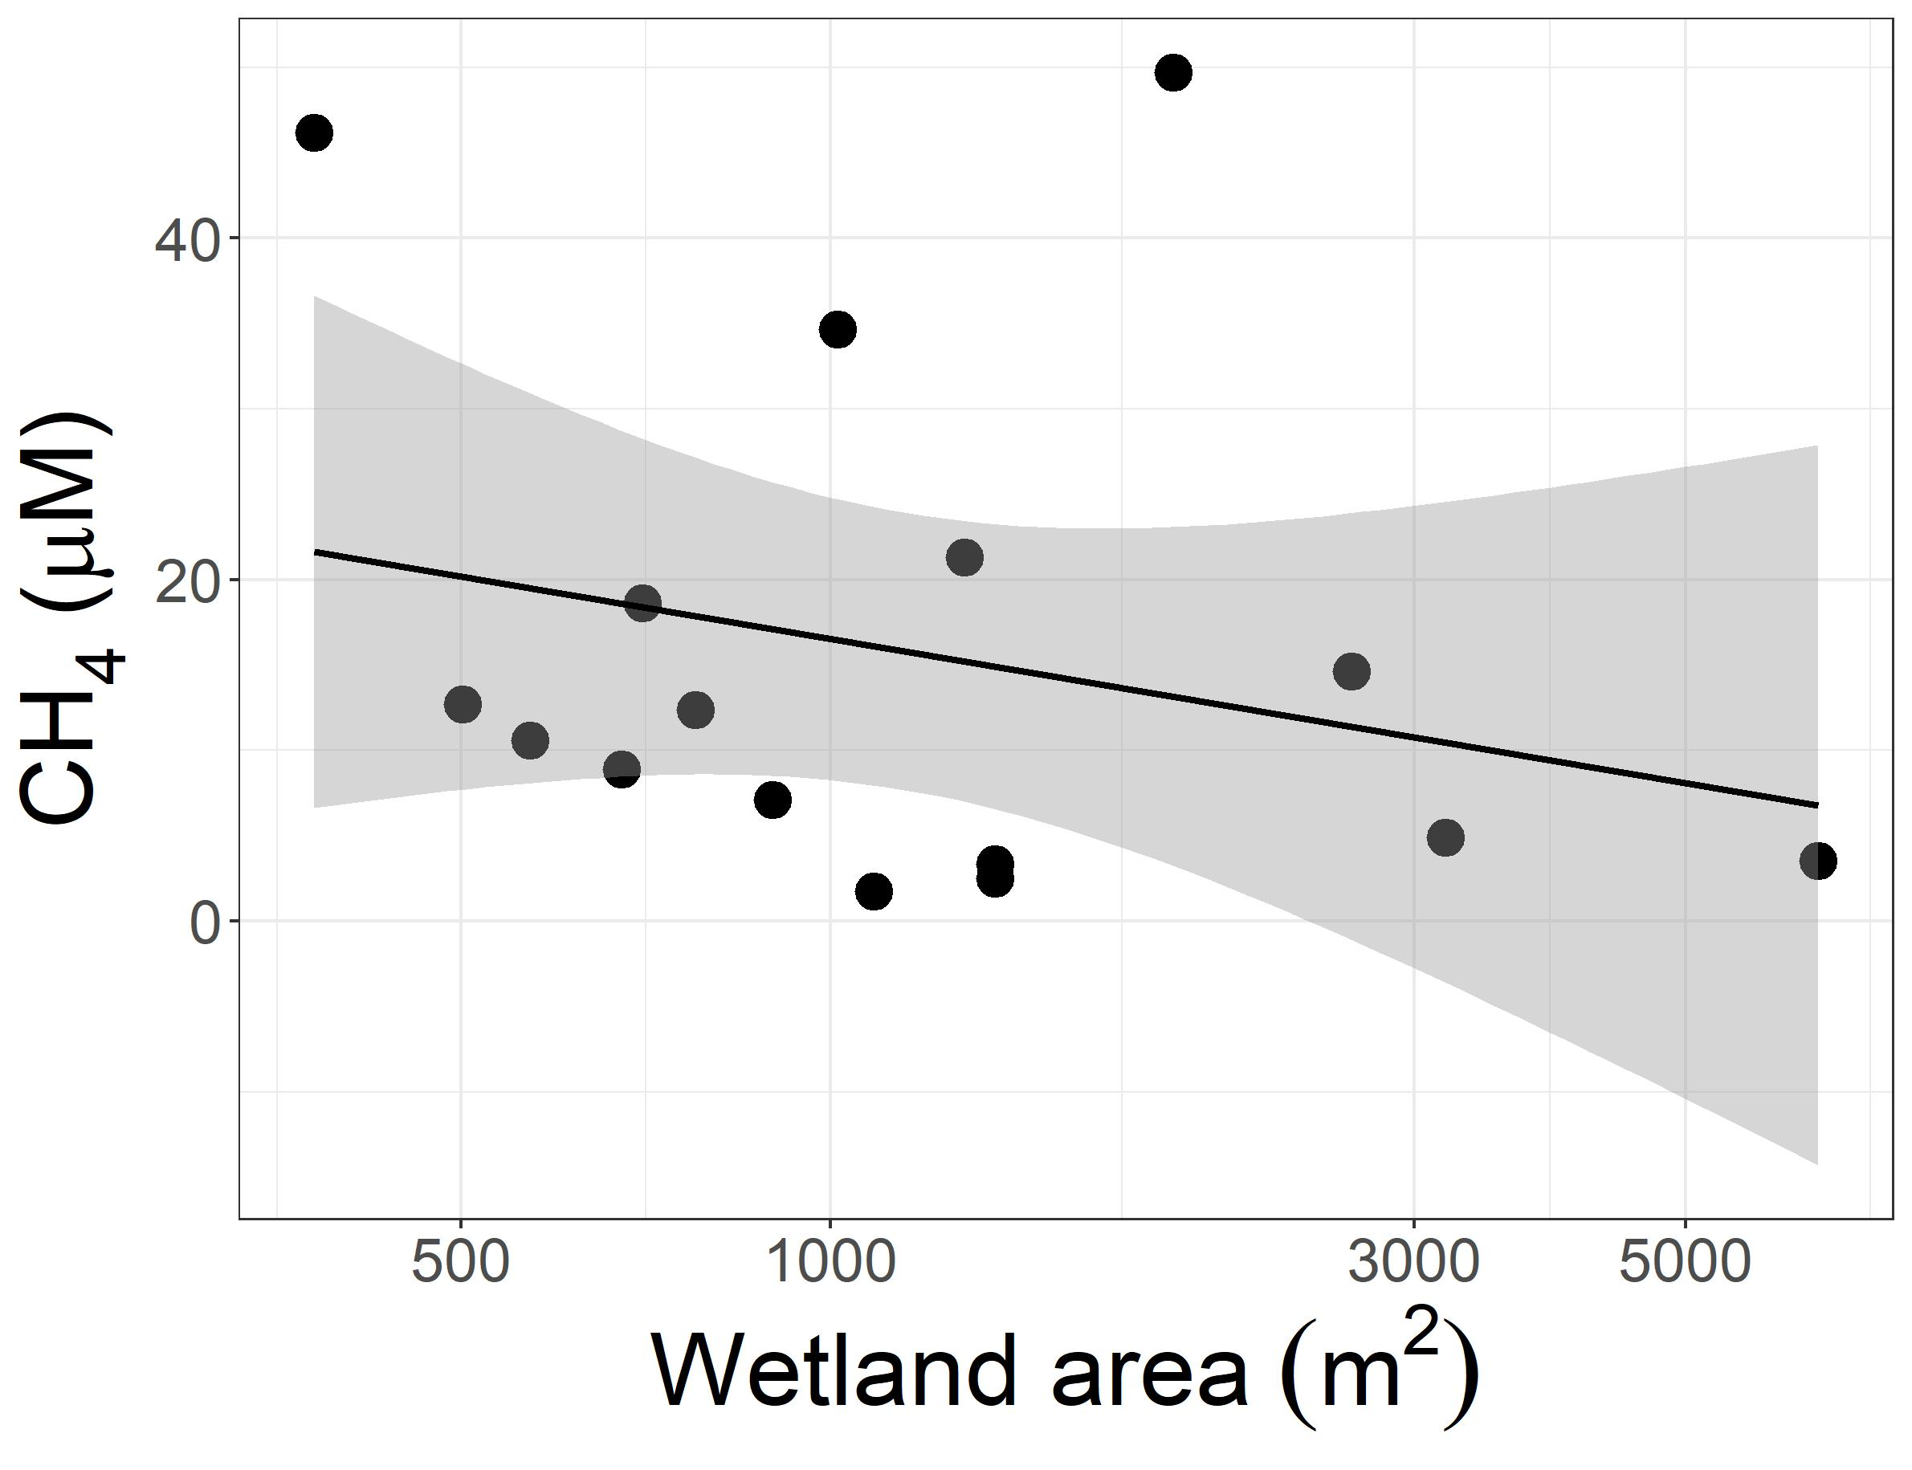
p-value = 0.3719
R² =
Multiple R-squared: 0.0573
Adjusted R-squared: -0.01004
p-value = 0.3719
R² = 0.01004

Slide 6
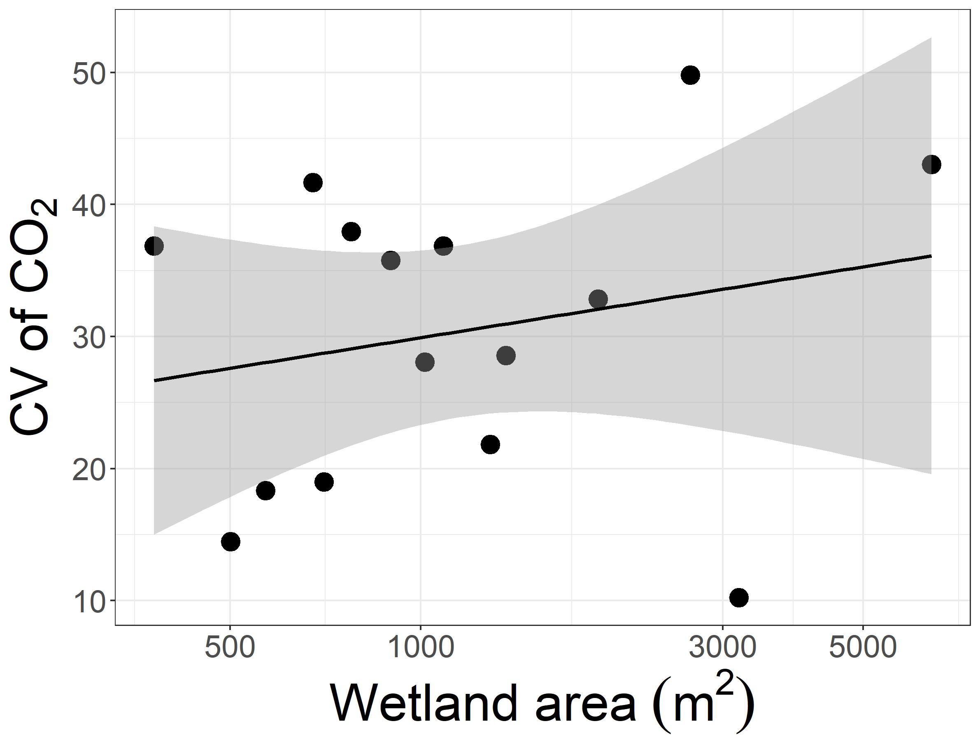
p-value = 0.3661
R² =
Multiple R-squared: 0.06319
Adjusted R-squared: -0.00887
p-value = 0.3661
R² = -0.00887

Slide 7
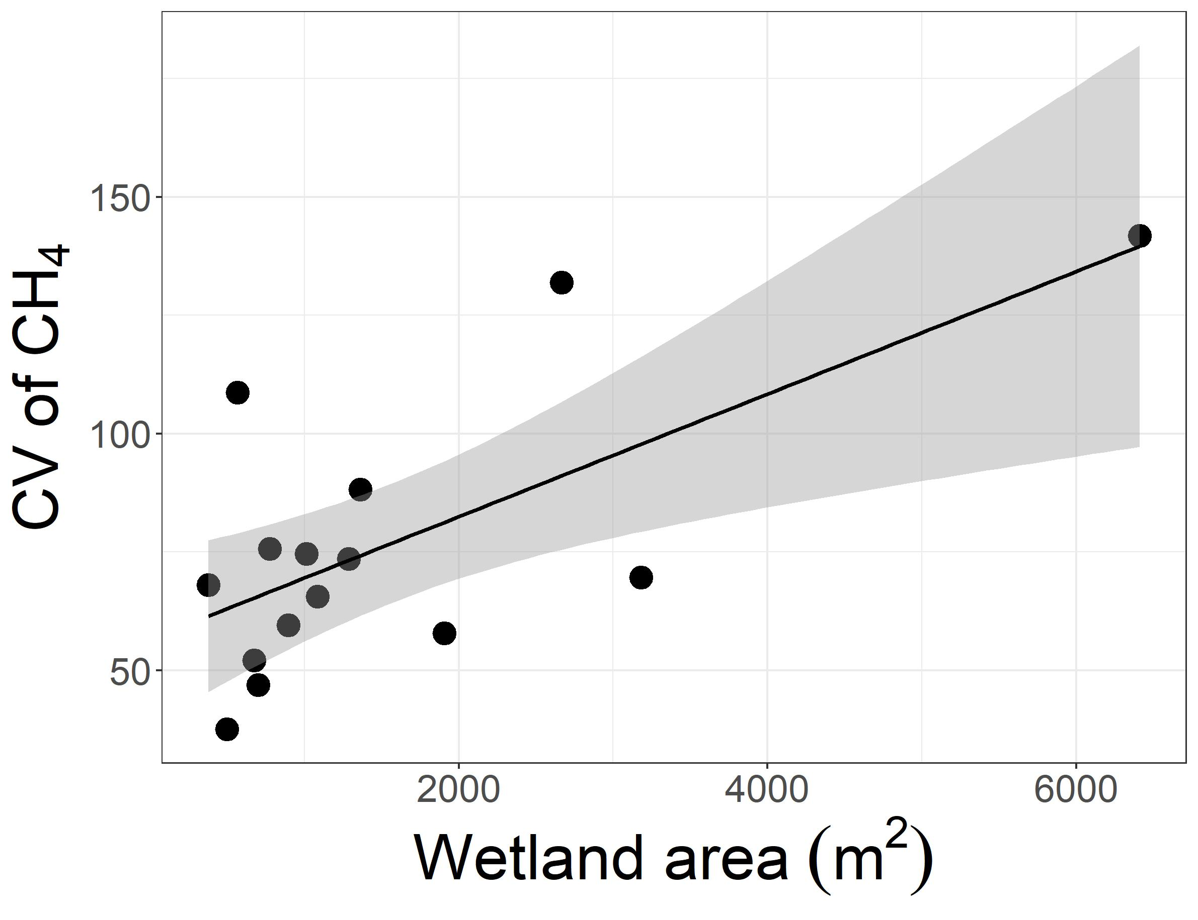
p-value = 0.005184
R² =
Multiple R-squared: 0.4639
Adjusted R-squared: 0.4226
p-value < 0.01
R² = 0.4226

